Slide 1


HTTP and REST Services
HTTP, RESTful Web Services, Promises, AJAX & Fetch API, ES6 Async/Await
SoftUni Team
Technical Trainers
Software University
https://softuni.bg

Slide 2
Table of Contents
HTTP Overview & Developer Tools
REST & RESTful Services
Accessing the GitHub API
Asynchronous Programing
Promises Basics
AJAX & Fetch API
ES6 Async/Await

Slide 3
Have a Question?
sli.do #js-front-end

Slide 4

HTTP Overview
Hypertext Transfer Protocol

Slide 5



HTTP Basics
HTTP (Hyper Text Transfer Protocol)
Text-based client-server protocol for the Internet
For transferring Web resources (HTML files, images, styles, etc.)
Request-response based
HTTP request
HTTP response
Web Client
Web Server

Slide 6






HTTP Request Methods
HTTP defines methods to indicate the desired action to be performed on the identified resource
Method | Description
GET | Retrieve / load a resource
POST | Create / store a resource
PUT | Update a resource
DELETE | Delete (remove) a resource
PATCH | Update resource partially
HEAD | Retrieve the resource's headers
OPTIONS | Returns the HTTP methods that the server supports for the specified URL

Slide 7
HTTP GET Request – Example
GET /users/testnakov/repos HTTP/1.1
Host: api.github.com
Accept: */*
Accept-Language: en
Accept-Encoding: gzip, deflate
User-Agent: Mozilla/5.0 (Windows NT 10.0; WOW64) AppleWebKit/537.36 (KHTML, like Gecko) Chrome/54.0.2840.71 Safari/537.36
Connection: Keep-Alive
Cache-Control: no-cache
<CRLF>
HTTP request line
HTTP headers
The request body is empty

Slide 8
HTTP POST Request – Example
POST /repos/testnakov/test-nakov-repo/issues HTTP/1.1
Host: api.github.com
Accept: */*
Accept-Language: en
Accept-Encoding: gzip, deflate
User-Agent: Mozilla/4.0 (compatible;MSIE 6.0; Windows NT 5.0)
Connection: Keep-Alive
Cache-Control: no-cache
<CRLF>
{"title":"Found a bug",
"body":"I'm having a problem with this.",
"labels":["bug","minor"]}
<CRLF>
HTTP request line
HTTP headers
The request body holds the submitted data

Slide 9
HTTP Response – Example
HTTP response status line
HTTP/1.1 200 OK
Date: Fri, 11 Nov 2016 16:09:18 GMT+2
Server: Apache/2.2.14 (Linux)
Accept-Ranges: bytes
Content-Length: 84
Content-Type: text/html
<CRLF>
<html>
<head><title>Test</title></head>
<body>Test HTML page.</body>
</html>
HTTP response headers
HTTP response body

Slide 10
HTTP Response Status Codes
Status Code | Action | Description
200 | OK | Successfully retrieved resource
201 | Created | A new resource was created
204 | No Content | Request has nothing to return
301 / 302 | Moved | Moved to another location (redirect)
400 | Bad Request | Invalid request / syntax error
401 / 403 | Unauthorized | Authentication failed / Access denied
404 | Not Found | Invalid resource
409 | Conflict | Conflict was detected, e.g. duplicated email
500 / 503 | Server Error | Internal server error / Service unavailable

Slide 11
Content-Type and Disposition
The Content-Type / Content-Disposition headers specify how the HTTP request / response body should be processed
JSON-encoded data
UTF-8 encoded HTML page. Will be shown in the browser
Content-Type: application/json
Content-Type: text/html; charset=utf-8
Content-Type: application/pdf
Content-Disposition: attachment; filename="Financial-Report-April-2016.pdf"
This will download a PDF file named Financial-Report-April-2016.pdf

Slide 12
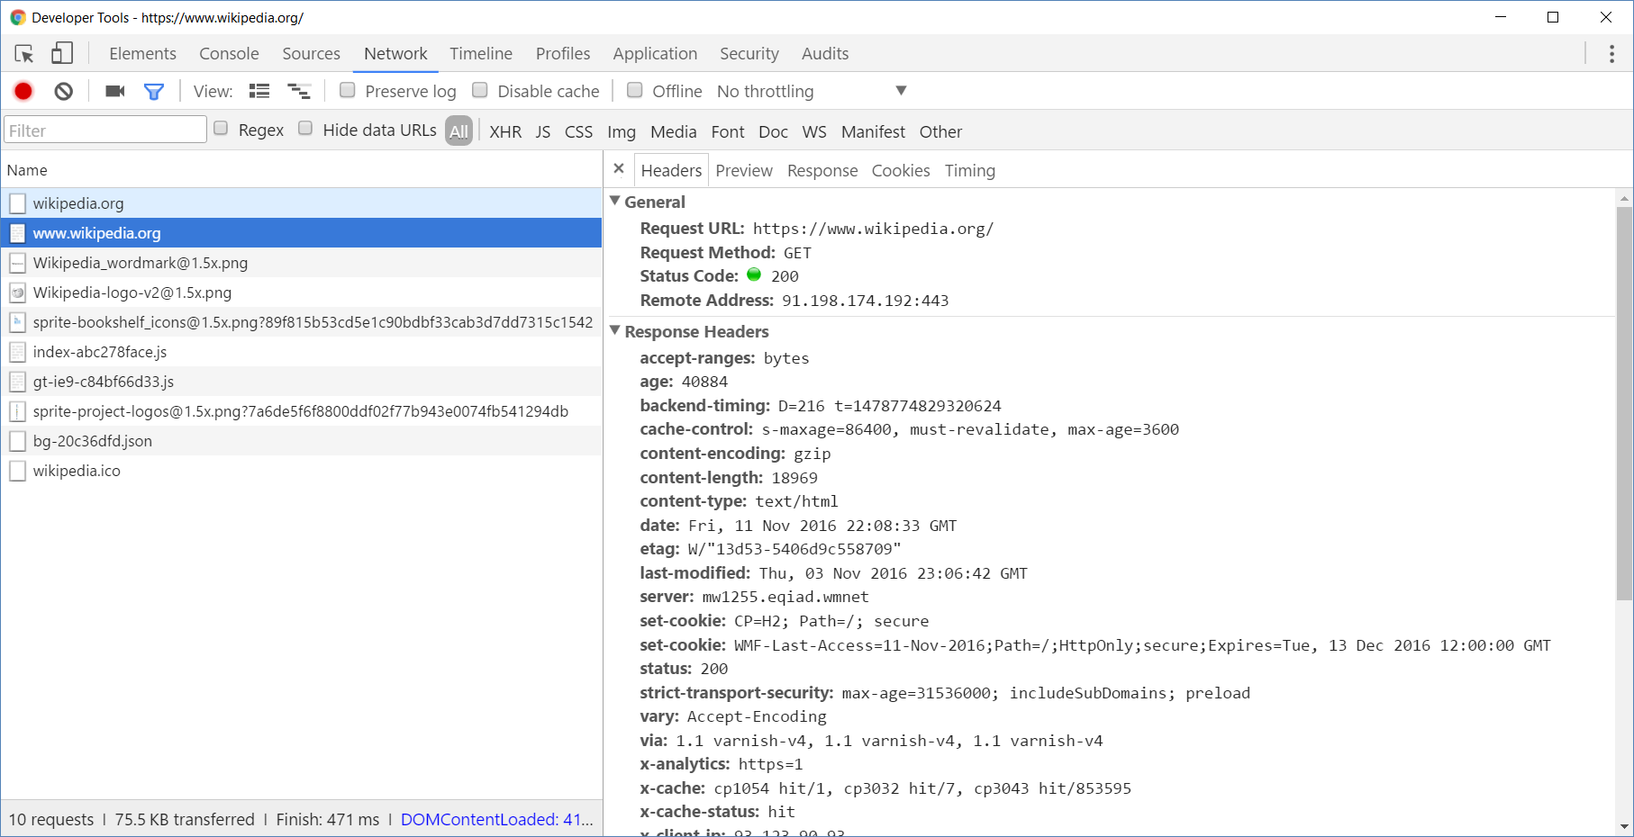
Browser Developer Tools

Slide 13
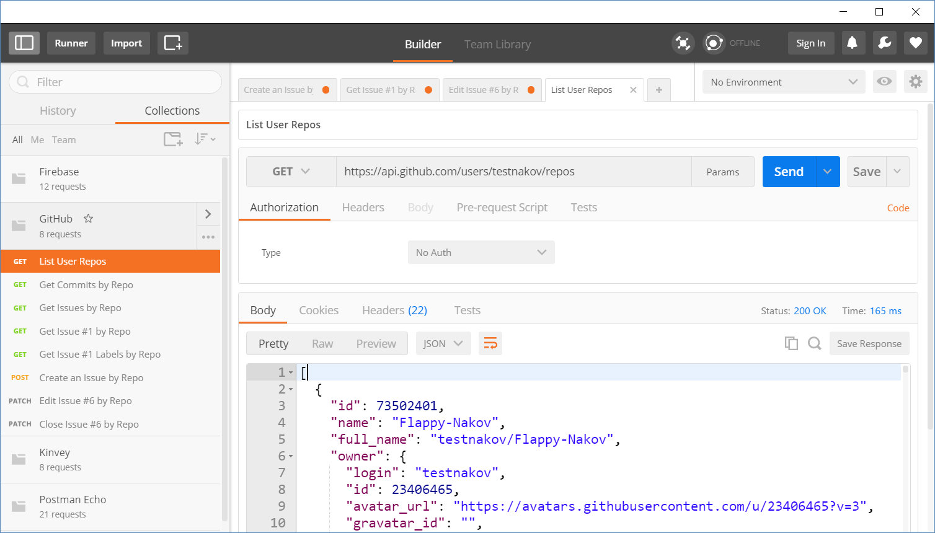
Postman
Read more about Postman REST Client

Slide 14
REST and RESTful Services
{REST}

Slide 15
REST and RESTful Services
Representational State Transfer (REST)
Architecture for client-server communication over HTTP
Resources have URI (address)
Can be created/retrieved/ modified/deleted/etc.
RESTful API/RESTful Service
Provides access to server-side resources via HTTP and REST
REST Web Service
URI
Resource
Representation 1
Representation 2
Representation 3
Representation 4
GET
PUT
POST
DELETE
Uniform Method

Slide 16

REST Architectural Constraints
REST defines 6 architectural constraints which make any web service a true RESTful API
Client-server architecture
Statelessness
Cacheable
Layered system
Code on demand (optional)
Uniform interface
Read more about REST Architectural Constraints

Slide 17
REST and RESTful Services – Example
Create a new post
Get all posts / specific post
Delete existing post
Replace / modify existing post
POST
http://some-service.org/api/posts
GET
http://some-service.org/api/posts
GET
http://some-service.org/api/posts/17
DELETE
http://some-service.org/api/posts/17
PUT/PATCH
http://some-service.org/api/posts/17

Slide 18

Accessing GitHub Through HTTP
GitHub REST API

Slide 19
GitHub API
List user's all public repositories:
Get all commits from a public repository:
Get all issues/issue #1 from a public repository
GET
https://api.github.com/users/testnakov/repos
GET
https://api.github.com/repos/testnakov/softuniada-2016/commits
GET
/repos/testnakov/test-nakov-repo/issues
GET
/repos/testnakov/test-nakov-repo/issues/1

Slide 20

Github: Labels Issue
Get the first issue from the "test-nakov-repo" repository
Send a GET request to:
https://api.github.com/repos/testnakov/test-nakov-repo/ issues/:id
Where :id is the current issue

Slide 21
GitHub API (2)
Get all labels for certain issue from a public repository:
Create a new issue to certain repository (with authentication)
GET
https://api.github.com/repos/testnakov/test-nakov-repo/issues/1/labels
POST
https://api.github.com/repos/testnakov/test-nakov-repo/issues
Headers
Authorization: Basic base64(user:pass)
Body
{"title":"Found a bug",
"body": "I'm having a problem with this."}

Slide 22
Github: Create Issue
Create an issue when you send a "POST" request
Use your Github account credentials to submit the issue

Slide 23

Synchronous vs Asynchronous
Asynchronous Programming

Slide 24
Asynchronous Programming in JS
Structured using callback functions
In current versions of JS there are:
Callbacks
Promises
Async Functions
Not the same thing as concurrent or multi-threaded
JS code is generally single-threaded

Slide 25
Asynchronous Programming
Runs several tasks (pieces of code) in parallel, at the same time
Synchronous
Asynchronous
Number of tasks
Number of tasks
1
1
20 seconds
20 seconds
2
2
7 seconds
7 seconds
3
3
10 seconds
10 seconds
4
4
8 seconds
8 seconds

Slide 26
Asynchronous Programming – Example
The following commands will be executed as follows:
console.log("Hello.");
setTimeout(function() {
console.log("Goodbye!");
}, 2000);
console.log("Hello again!");
// Hello.
// Hello again!
// Goodbye!

Slide 27
Callbacks
Function passed into another function as an argument
Then invoked inside the outer function to complete some kind of routine or action
function running() {
return "Running";
}
function category(run, type) {
console.log(run() + " " + type);
}
category(running, "sprint"); //Running sprint
Callback
function

Slide 28

Promises
Objects Holding Asynchronous Operations

Slide 29
What is a Promise?
A promise is an asynchronous action that may complete at some point and produce a value
States:
Pending - operation still running (unfinished)
Fulfilled - operation finished (the result is available)
Failed - operation failed (an error is present)
Promises use the Promise class
new Promise(executor);

Slide 30
Promise Flowchart
Promise resolves with data or throws error
Constructor takes Executor function as parameter
return data
throw error
Promise
Executor
resolve
reject
Success callback
then
Error callback
catch

Slide 31
Promise.then() – Example
console.log('Before promise');
new Promise(function(resolve, reject) {
setTimeout(function() {
resolve('done');
}, 500);
})
.then(function(res) {
console.log('Then returned: ' + res);
});
// Before promise
Resolved after 500 ms
// After promise
// Then returned: done
console.log('After promise');

Slide 32
Promise.catch() – Example
console.log('Before promise');
new Promise(function (resolve, reject) {
setTimeout(function () {
reject('fail');
}, 500);
})
.then (function (result) { console.log(result); })
.catch (function(error) { console.log(error); });
Rejected after 500 ms
console.log('After promise');

Slide 33
Popular Promise Methods
Promise.reject(reason)
Returns an object that is rejected with the given reason
Promise.resolve(value)
Returns an object that is resolved with the given value
Promise.finally()
The handler is called when the promise is settled
Promise.all(iterable)
Returns a promise
Fulfills when all of the promises have fulfilled
Rejects as soon as one of them rejects

Slide 34
AJAX
A AX
Connecting to a Server via Fetch API

Slide 35
What is AJAX?
Asynchronous JavaScript And XML
Background loading of dynamic content/data
Load data from the Web server and render it
Some examples of AJAX usage:
Partial page rendering
Load HTML fragment + show it in a <div>
JSON service
Loads JSON object and displays it

Slide 36
AJAX: Workflow
Client
Web Server
HTTP request (initial page load)
Browser
Static
HTTP response (HTML page)
JS App
REST

Slide 37
AJAX: Workflow
Client
Web Server
Browser
Static
JS App
AJAX request
UI Interaction
REST
AJAX handler
Returns data as JSON

Slide 38
What is Fetch?
The Fetch API:
Allows making network requests
Uses Promises
Enables a simpler and cleaner API
Makes code more readable and maintainable
fetch('./api/some.json')
.then(function(response) {…})
.catch(function(err) {…})

Slide 39
Basic Fetch Request
The response of a fetch() request is a Stream object
The reading of the stream happens asynchronously
When the json() method is called, a Promise is returned
The response status is checked (should be 200) before parsing the response as JSON
if (response.status !== 200) {
// handle error
}
response.json()
.then(function(data) { console.log(data)})

Slide 40
GET Request
Fetch API uses the GET method so that a direct call would be like this
fetch('https://api.github.com/users/testnakov/repos')
.then((response) => response.json())
.then((data) => console.log (data))
.catch((error) => console.error(error))

Slide 41
Problem: GitHub Repos
Execute an AJAX GET Request to load all repos of a user
Use the Fetch API
Use the following URL:
https://api.github.com/users/testnakov/repos
In the first then() block map the response to text
In the second then() block display the content in a div

Slide 42
POST Request
To make a POST request, we can set the method and body parameters in the fetch() options
fetch('/url', {
method: 'post',
headers: { 'Content-type': 'application/json' },
body: JSON.stringify(data),
})

Slide 43
Body Methods
json() resolves the promise with JSON
text() resolves the promise with string
blob() resolve body with Blob (file, image, etc.)
formData() resolve body with FormData

Slide 44
Chaining Promises
When working with a JSON API, you can:
Define the status and JSON parsing in separate functions
The functions return promises which can be chained
fetch('users.json')
.then(status)
.then(json)
.then(function(data) {…})
.catch(function(error) {…});

Slide 45
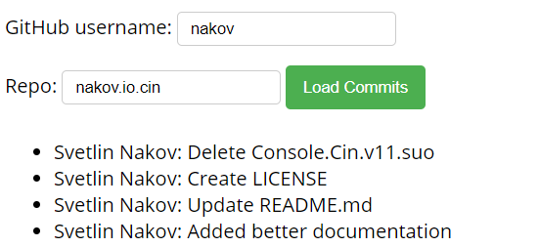
Problem: Load GitHub Commits
GitHub username:
<input type="text" id="username" value="nakov" /> <br>
Repo: <input type="text" id="repo" value="nakov.io.cin" />
<button onclick="loadCommits()">Load Commits</button>
<ul id="commits"></ul>
<script>
function loadCommits() {
// Use Fetch API
}
</script>

Slide 46

Async / Await
ES6 Simplified Promises

Slide 47
Async Functions
Returns a promise, that can await other promises in a way that looks synchronous
Contains an await expression that:
Is only valid inside async functions
Pauses the execution of that function
Waits for the Promise's resolution

Slide 48
Async Functions (2)
function resolveAfter2Seconds() {
return new Promise(resolve => {
setTimeout(() => {
resolve('resolved');
}, 2000);
});
}
Expected output:
// calling
// resolved
async function asyncCall() {
console.log('calling');
let result = await resolveAfter2Seconds();
console.log(result);
}

Slide 49
Error Handling
async function f() {
try {
let response = await fetch();
let user = await response.json();
} catch (err) {
// catches errors both in fetch andresponse.json
alert(err);
}}
async function f() {
let response = await fetch();
} // f() becomes a rejected promise
f().catch(alert);

Slide 50
Async/Await vs Promise.then
Promise.then
Async/Await
function logFetch(url) {
return fetch(url)
.then(response => {
return response.text()
})
.then(text => {
console.log(text);
})
.catch(err => {
console.error(err);
});
}
async function logFetch(url) {
try {
const response =
await fetch(url);
console.log(
await response.text()
);
}
catch (err) {
console.log(err);
}
}

Slide 51
Sequential Execution
To execute different promise methods one by one, use Async /Await
function execute(x,sec) {
return new Promise(resolve => {
console.log('Start: ' + x);
setTimeout(() => {
console.log('End: ' + x);
resolve(x);
}, sec *1000); }); }
// Start: 1
// End: 1
// Start: 2
// End: 2
// Start: 3
// End: 3
// 6
async function serialFlow() {
let result1 = await execute(1, 1);
let result2 = await execute(2, 2);
let result3 = await execute(3, 3);
let finalResult = result1 + result2 + result3;
console.log(finalResult);
}

Slide 52
Summary
…
…
…
HTTP is text-based request-response protocol
RESTful services address resources by URL
Provide CRUD operations over HTTP
Asynchronous programming
Promises hold operations – resolve & reject
AJAX & Fetch API – connect to a server
ES6 Async/Await Expression

Slide 53
Questions?
Notes:
53

Slide 54














SoftUni Diamond Partners

Slide 55

Educational Partners

Slide 56
Trainings @ Software University (SoftUni)
Software University – High-Quality Education, Profession and Job for Software Developers
softuni.bg, softuni.org
Software University Foundation
softuni.foundation
Software University @ Facebook
facebook.com/SoftwareUniversity
Software University Forums
forum.softuni.bg
Notes:
56

Slide 57

License
This course (slides, examples, demos, exercises, homework, documents, videos and other assets) is copyrighted content
Unauthorized copy, reproduction or use is illegal
© SoftUni – https://softuni.org
© Software University – https://softuni.bg
Notes:
57

